Slide 1
Long-term Caregivers
HIV Prevention Competencies and Precautions
Taiwan Centers for Disease Control, Ministry of Health and Welfare

Slide 2
Outline
HIV Prevention Competencies
Epidemic Status in Taiwan
Introduction to HIV and AIDS
HIV Prevention and Treatment
Protection Awareness of Care for HIV Infected People
Risk of HIV Exposure
Standard Precautions and Principles
Post-Exposure Prevention
Misconception FAQ
Zero Discrimination

Slide 3
Outline
HIV Prevention Competencies
Epidemic Status in Taiwan
Introduction to HIV and AIDS
HIV Prevention and Treatment
Protection Awareness of Care for HIV Infected People
Risk of HIV Exposure
Standard Precautions and Principles
Post-Exposure Prevention
Misconception FAQ
Zero Discrimination

Slide 4
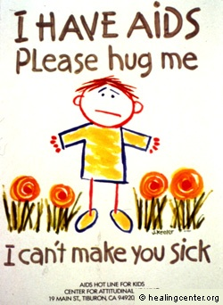
When talking about HIV, what is the first thing that comes to mind?
A communicable disease
Homosexuality
Sexual intercourse
Sex abuse
A deadly disease
Sexually transmitted disease (STD)
Drugs
Depressive disorder
…etc

Slide 5
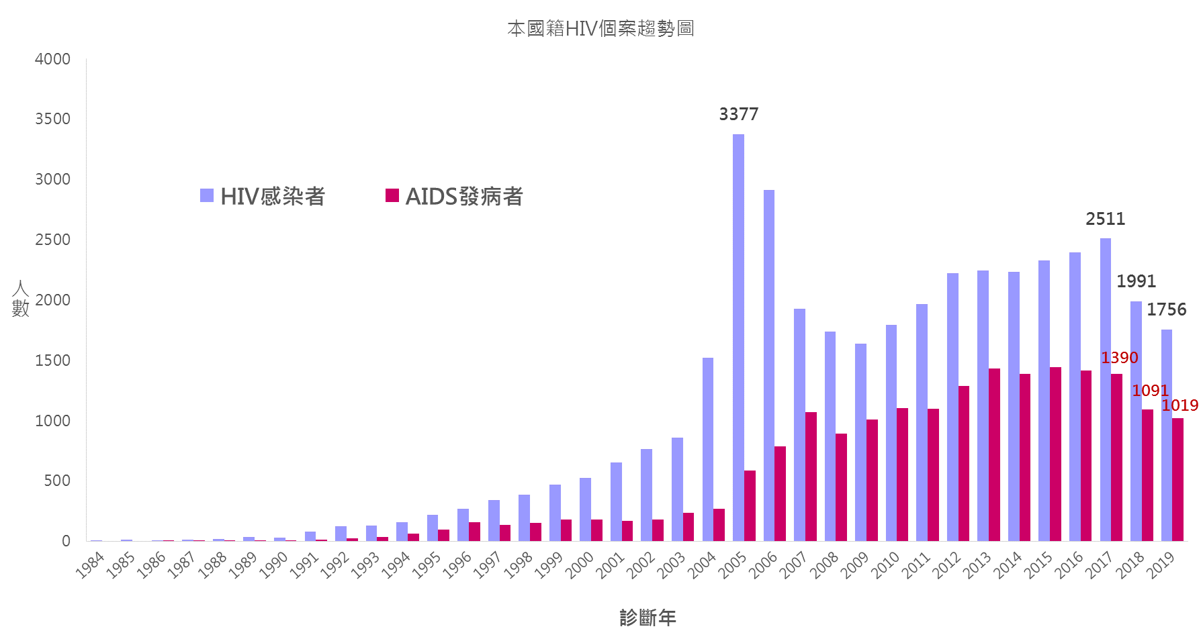
Reported HIV/AIDS Patients in Taiwan (1984-2019)
39,669
18,921
6,784
Accumulated HIV Infected Cases
Accumulated AIDS Cases
Accumulated Deaths
Cases
The number of new cases reduces year by year through active promotion of comprehensive screening, diagnose, and immediate medication strategies.
Taiwan has a low HIV prevalence.
Year

Slide 6
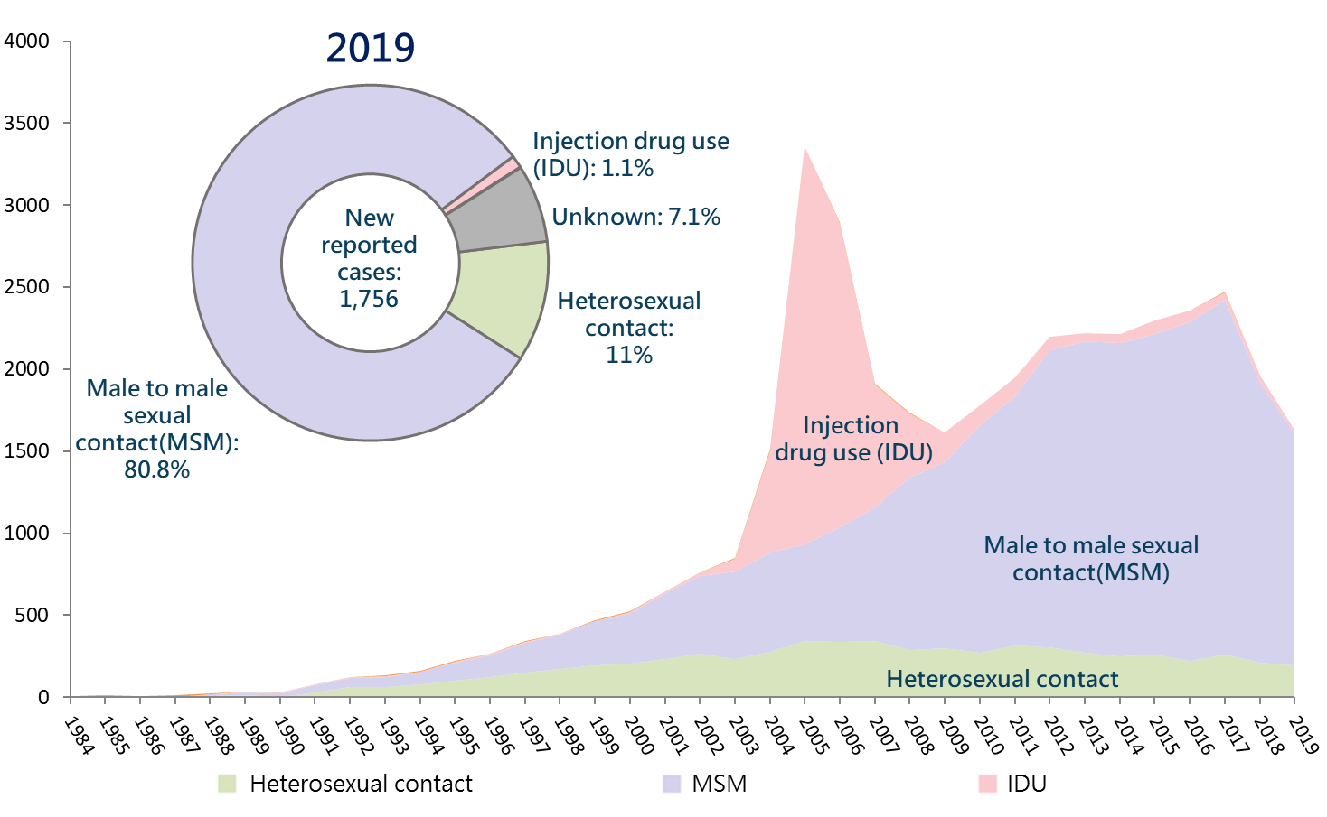
Epidemic Status in Taiwan: Unsafe sexual behavior is the major path of transmission

Slide 7
UNAIDS 90–90–90 Targets 2020
Achieve the UNAIDS 90–90–90 targets by 2020
to end the HIV epidemic by 2030.
90%
90%
90%
of all people living with HIV will know their HIV status.
of all people with diagnosed HIV infection will receive sustained antiretroviral therapy.
of all people receiving antiretroviral therapy will have viral suppression.
UNAIDS 90–90–90 Targets mean to achieve the following by 2020:
HIV viral loads are undetected in blood, as healthy as ordinary people, transmission risk reduced significantly.

Slide 8
Achievement of UNAIDS 90-90-90 2020 in Taiwan
Aware of their HIV status
On HIV treatment
Virally
suppressed
Transmission risk
reduced significantly
Taiwan
2019
87%
90%
95%
Global
2018
79%
78%
86%
Taiwan’s UNAIDS 90-90-90 performance is above the global average.
Most people living with diagnosed HIV have received antiretroviral
therapy with viral suppression.

Slide 9
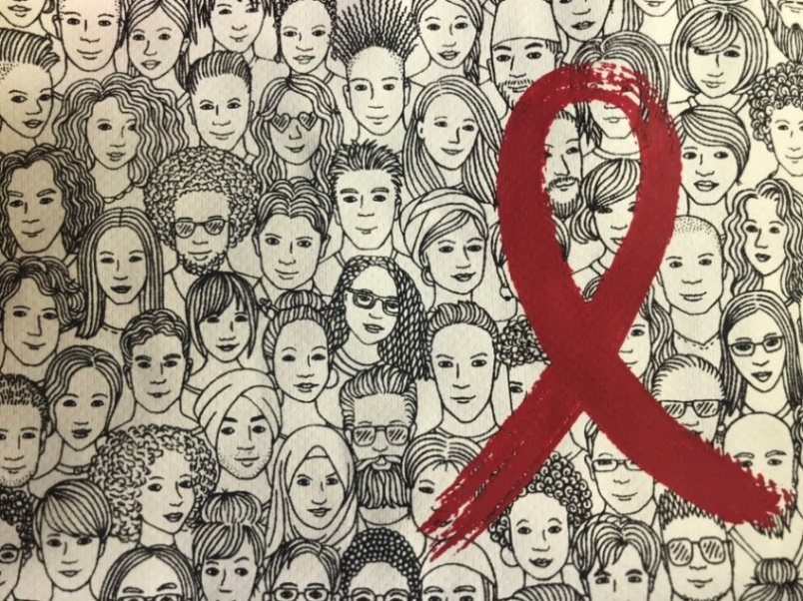
Do HIV infected people look like ordinary people?
The incubation period from HIV infection until development of AIDS is up to 10 years for young adults. During incubation, there is no sign of infection in infected patients.
They may not know that they are infected.

Slide 10
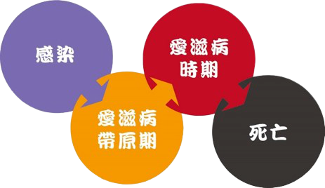
Does HIV infection mean AIDS?
AIDS Illness State
Infection
HIV Carrier State
Death
Initial Stage
Infected without symptom ▼HIV Infection
Late Stage
Illness state ▼AIDS
Defeat Human Immune System
HIV Infection
AIDS
In the absence of effective medication control, HIV infection can cause physical immunodeficiency to give rise of infections or tumors waiting for complication. The condition is thus called the acquired immunodeficiency syndrome, as known as AIDS.
The “human immunodeficiency virus” is commonly called “HIV”. It is a virus that defeats the human immune system.

Slide 11
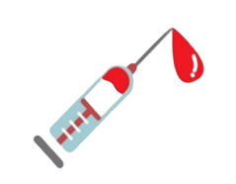
What are the routes of HIV transmission?
Unsafe sexual behavior
Mother-to-child transmission
未保護的性行為
Blood Exchange
Receiving or contracting HIV infected blood products. Sharing needles, syringes or diluents that have been used by people who are infected.
Oral sex, anal sex, vaginal sex or other form of exchange of bodily fluids.
Mothers directly transmit HIV to newborns during pregnancy, delivery, or breastfeeding.
HIV is transmitted through bodily fluids (blood, semen, vaginal fluids, and breast milk) of a person who has HIV via the mucous membrane or wounded skin (damaged tissue) of a person who has no HIV

Slide 12
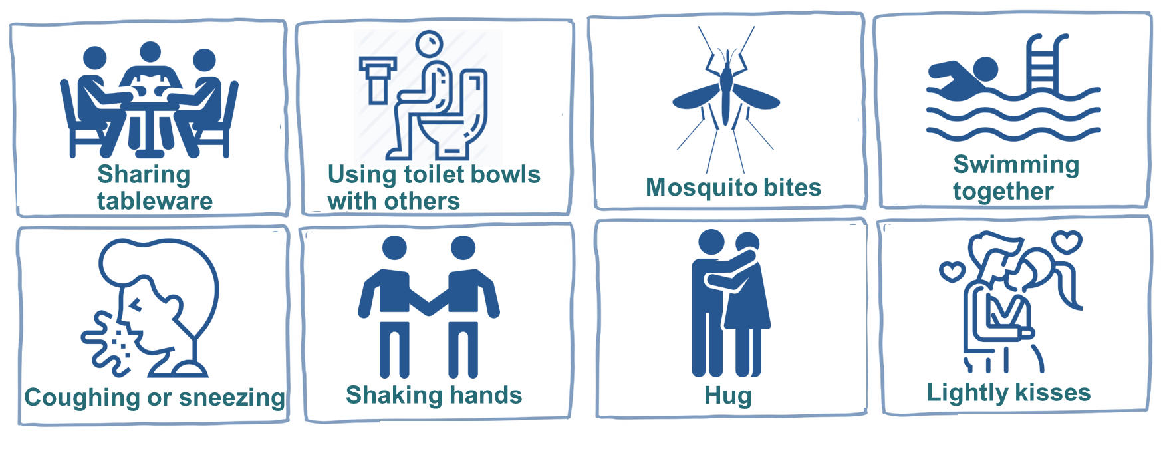
HIV WILL NOT be transmitted in the following situations
You will not get HIV from people who have HIV in daily life contact.

Slide 13
Prevention
HIV is transmitted through sexual intercourse and blood or bodily fluids. Therefore, there is no risk of infection in general behaviors.
Using condoms correctly throughout the sex together with water-based lubricants can effectively prevent the infection of HIV and other STDs.
Avoid tattooing and ear piercing and do not share implements, such as razors, shavers, toothbrushes, and so on, with others.
Do not share needles, syringes, or diluents with others.

Slide 14
Treatment
Patients can get good control with the highly active antiretroviral therapy (HAART). After regular HAART for a while, a great number of patients regain health like ordinary people, and even HIV viral loads are undetectable, significantly lowering the possibility of transmitting to others.
Receiving treatment, taking medication regularly,
and maintaining HIV viral loads undetected.
→Maintain normal Immune functions
→Reduces transmission
→Although HIV is incurable, it is controllable and no
more a deadly disease.

Slide 15
HIV Treatment Strategy: Immediate Medication After Diagnosis
Taiwan began implementing the “immediate medication after diagnosis” strategy in 2016 with low-side-effect new HIV medication (3-in-1 compound formula, one time a day (QD), one tablet each time) to enhance the treatment proportion and obedience of infected people.
HIV infection has become a controllable chronic disease. As long as they stay with each appointment and following all physical orders, infected people can regain health like ordinary people.
When HIV viral loads are suppressed to an undetected state, infected people using HIV medication almost will not transmit HIV through sex.
In Taiwan, 95% of diagnosed people receiving antiretroviral therapy have undetected HIV viral loads!
(Undetected HIV viral loads in blood = good control).

Slide 16
Outline
HIV Prevention Competencies
Epidemic Status in Taiwan
Introduction to HIV and AIDS
HIV Prevention and Treatment
Protection Awareness of Care for HIV Infected People
Risk of HIV Exposure
Standard Precautions and Principles
Post-Exposure Prevention
Misconception FAQ
Zero Discrimination

Slide 17
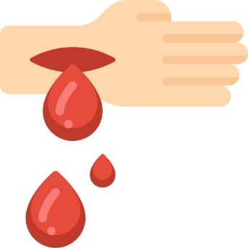
Risk of HIV Exposure
Basic conditions of transmission:
HIV can only be transmitted from one person to another when all three conditions are met
＋
＋
(Contact)
Open wounds on the skin or mucous membrane of caregivers.
HIV-containing bodily fluids
Viral loads/density
HIV dies very soon after leaving the human body and cannot survive in the environment.

Slide 18
What are the high-risk fluids of transmission?
Non-infectious
Infectious
Blood, semen, vaginal fluids, cerebrospinal fluids, synovial fluids, pleural fluids, ascites, amniotic fluid, breast milk
Saliva, sputum, nasal secretions, tears, sweat, urine, feces, vomit, skin vesicles.

Slide 19
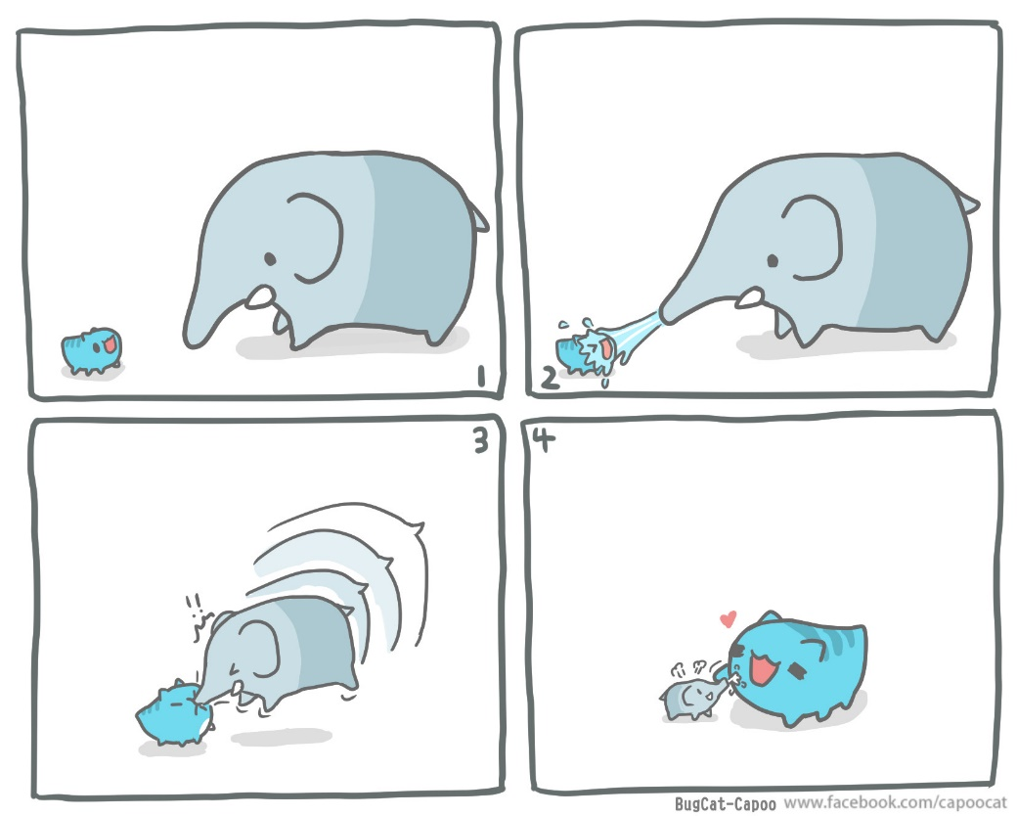
Therefore, caregivers will not be exposed to HIV in ordinary care
Care Work
Helping with oral hygiene (including brushing teeth and rinsing)
Helping with changing clothes.
Changing beddings.
Helping with nail trimming.
Caregivers will not get infected when contracting with sweat, tears, saliva, urine, vomit, or feces of an infected person.

Slide 20
Standard Precaution
Considering the following as transmittable infective agents is the basic principle:
Blood
Bodily fluids
Open wounds of skin
or mucous membrane

Slide 21
Standard Precaution
It is estimated that 13% of infected people do not know their infection status.
Caregivers should follow the standard precautions while giving care to both suspected cases and confirmed cases.
Related precautions include hand hygiene and the use of surgical gloves before contacting possible exposures.
According to the standard precautions, following the standard precautions is always the best way for protection when contacting fluids of any kind.

Slide 22
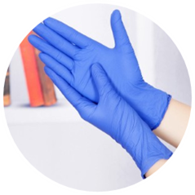
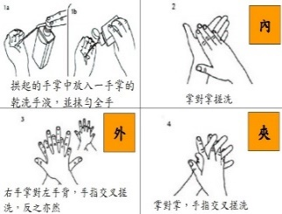
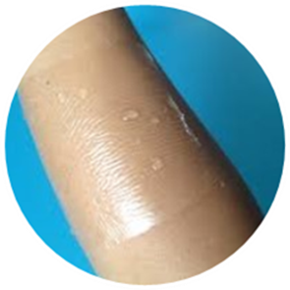
Principles of Standard Precautions
When it needs to contact with blood or bodily fluids
Always wear surgical gloves. Remove gloves immediately afterwards and wash hands with water and cleaning solutions.
After contacting blood or bodily fluids with the hands or skin
Wash hands with cleaning solutions or hand sanitizers according to the standard hand washing procedures.
Environments or objects contaminated by blood or bodily fluids
Dilute bleach with 100 times of water.
Open wounds or dermatitis on skin
After contacting with blood or bodily fluids, seal the wound well with waterproof tapes.
Please refer to the Infection Control Precautions and Guidelines for Long-Term Care Institutions and Standard Precautions published by Taiwan Centers for Disease Control.

Slide 23
Post-Exposure Prophylaxis 1
Immediately wash the exposed wounds
Percutaneous sharp injuries.
Immediately squeeze out the blood in the wounds and wash the wounds with tap water and soap.
Skin wound exposure
Wash wounds with tap water and soap.
Mucous membrane exposure
Wash with a large amount of tap water.
Immediately consult a doctor at a designated HIV hospital as an emergency to evaluate the risk of HIV infection.

Slide 24
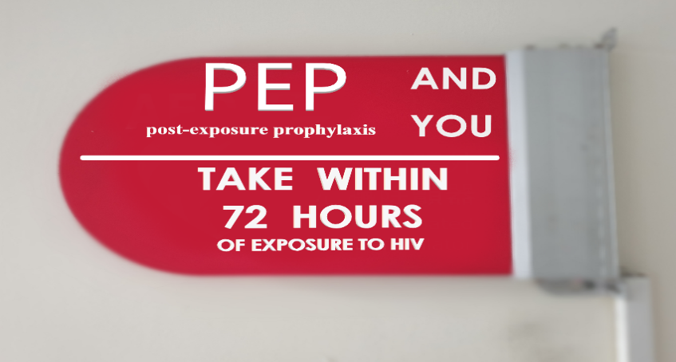
Post-Exposure Prophylaxis 2：
Post-Exposure Prophylaxis (PEP) Flowchart
After accidently exposing an open wound to a patient’s blood or bodily fluids in caregiving with risk of infection.
Immediately consult a doctor at a designated HIV hospital as an emergency to evaluate the risk of HIV infection.
Within 72 hours, prescribe PEP to those being potentially exposed to HIV.
Remember!! Take ART medicines in the next 28 days continuously according to the physician’s order.
Get HIV screening according to the follow-up schedule.

Slide 25
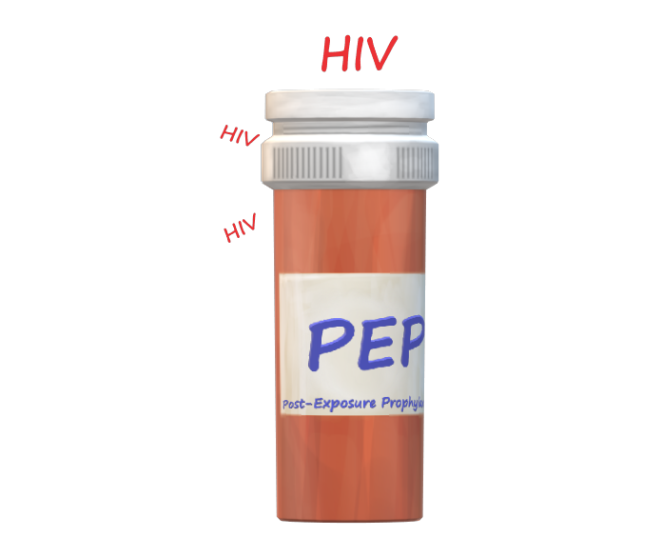
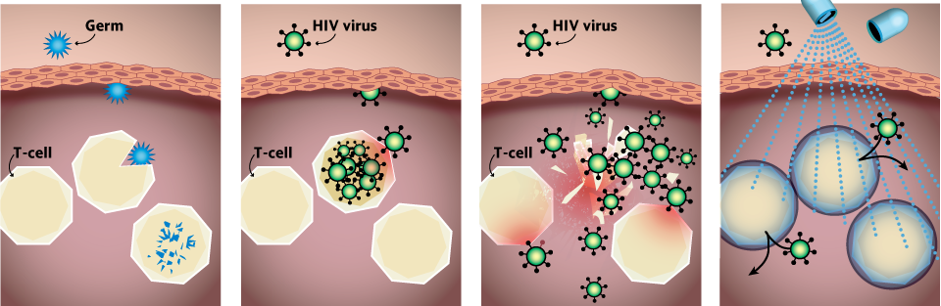
Post-Exposure Prophylaxis：
Post-Exposure Prophylaxis (PEP)
Protect cells with medication from permanent infection.
Side effects vary among people and will go off after medication discontinuation.

Slide 26
The government will subsidize PEP for those who have accidentally exposed to HIV when carrying out their duties.
What documents are required for application?
The applicant unit shall submit the following documents in their applications:
(1) Receipt of the applicant unit.
(2) Original copy of the receipt for the healthcare service expenses
(3) Details of the expenses
(4) Medical record summary
(5) Exposure description
(6) Report on accidental HIV exposure during duty
(7) Needlestick injury follow-up record
Is there a time-limit (deadline) for application?
Yes.
Your employer must send an official report to the local health authority within six months after the exposure to apply for a preliminary review and related expenses.
Where should these documents be sent?
After related documents are delivered to the local health authority it will forward to Taiwan CDC for a second review and fund disbursement.

Slide 27
Designated HIV hospitals
Currently, there are 79 designated HIV hospitals in Taiwan
(there is also one designated HIV clinic)
providing care and consultation services relating to HIV prevention.

Slide 28
Misconceptions About HIV
Initial Stage
Infected without incidence ▼HIV Infection
Illness state ▼AIDS
Late Stage
Infection is incidence?
Contacts with bodily fluids mean risk of infection?
Saliva, sputum, nasal secretions, tears, sweat, urine, feces, vomit, skin vesicle
→Not Infectious.

Slide 29
Misconceptions About HIV
Is HIV a deadly disease?
Following the outcome of various types of new medication, HIV is no more the Black Death of the 20th century. The average life expectancy of HIV patients is the same as that of non-patients. In fact, HIV has become a chronic disease like hypertension and diabetes.
Are sexual orientation and HIV infection correlated?
No disease can infect people by gender or sexual orientation. Only safe sexual behavior (correctly use condoms throughout the sex and water-based lubricant) can prevent HIV and other STDs.

Slide 30
HIV Infection FAQ-1
Q
Will HIV be transmitted through the toilet bowl or laundry equipment?
No.
HIV is transmitted through fluids and blood exchange, including unsafe (unprotected) sexual behaviors without using condoms throughout the sex; sharing needles, syringes, or diluents with others; or mother-to-child (perinatal transmission) transmission; whole secretions such as feces, urine, saliva, and sweat will not transmit HIV. Therefore, HIV will not be transmitted in normal daily life.
A

Slide 31
HIV Infection FAQ-2
Will HIV be transmitted by mosquito bites? Will a mosquito transmit HIV after biting an “HIV-infected person”?
Q
No.
HIV will not be transmitted by insect bites, such as mosquito bites and fly bites.The viral load in the residual blood on the surface of arthropod mouthparts is not enough to transmit viruses. Also, arthropods need some rest to digest blood after sucking and will not bite another person immediately afterwards. In addition, mosquitoes will only suck blood and will not spit it out. Therefore, they will not transmit HIV.
A
A

Slide 32
HIV Infection FAQ-3
Q
Will HIV be transmitted by human bites of an infected person?
No.
The victim contacts only with the biter’s (HIV-infected person) saliva and oral mucous membrane. As saliva will not transmit HIV, and the oral mucous membrane will possibly transmit HIV only when there are wounds and it is bleeding, HIV transmission by human bites is almost impossible.
A
A

Slide 33
HIV Infection FAQ-4
Q
Will HIV be transmitted through drinking the same glass of water?
A
No.
As saliva almost does not transmit HIV, drinking the same glass of water and a lightly kiss with HIV-infected people will not get infected.
A

Slide 34
Zero Discrimination
According to worldwide research, after taking medication, the viral load on infected people is undetectable, significantly lowering the risk of transmission.
Caregivers will not get infected by giving ordinary care (turning the body, cleansing, and body contacts).HIV is transmitted via bodily fluids and blood exchange, while secretions like feces, urine, saliva, and sweat will not transmit HIV. Therefore, we will not be infected by HIV in the daily life.
02
We can hug, shake hands with, dine with, and use the same phone with a person who has HIV in the daily life.

Slide 35
Conclusions
HIV is mainly transmitted through the bodily fluids (blood, semen , vaginal fluids, and breast milk) of a person who has HIV from unsafe sexual behaviors.
HIV has been considered as a chronic disease. Taking medication regularly can control viral loads to maintain health condition.
Caregivers of a person who has HIV should remind the case to stay with every appointment and take medication steadily to control the viral load inside the body.
HIV will not be transmitted in ordinary care in the daily life.
If a long-term caregiver accidentally exposes to HIV when carrying out duties, get medical attention within 72 hours after exposure for HIV screening and determined by doctors to see if PEP usage is needed. The government will subsidize the healthcare expense.

